Slide 1
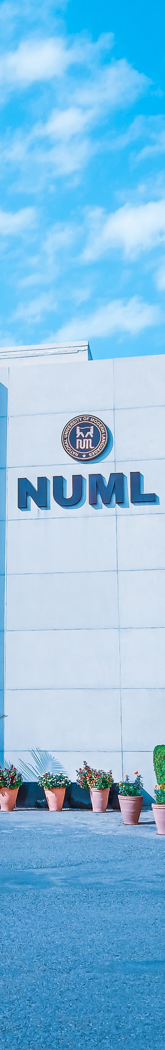

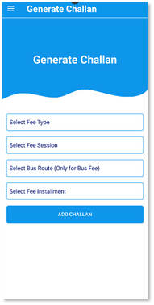
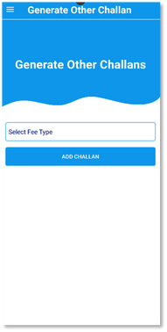
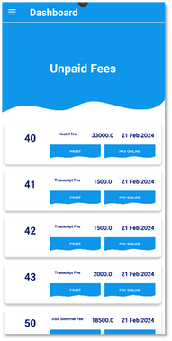
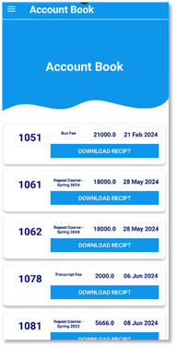
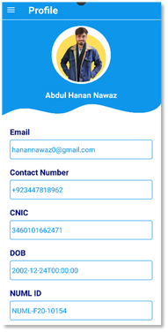
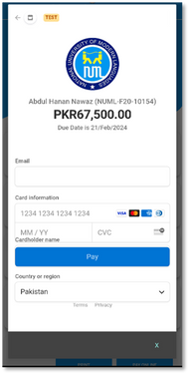












Open House 2024
NUMLPay
One Click Solution
We, along with our fellow students, have faced the inconvenience of waiting in long queues at the bank to pay fees. NUMLPay was developed to streamline this process, offering a quick, easy, and efficient online payment system to save time and reduce hassle for everyone.
Benefits & Features
Tech Stack & Tools of NUMLPay
Online Payment
Big Data Tool
Simplyfing all fee payments online
Handle all Campuses
Handle all type of Students
Department of Software Engineering,
Faculty of Engineering and Computing
NUML
Mr. Mohsin Abbas
Lecturer @ NUML
Supervisor
Abdul Hanan Nawaz
Data Software Engineer
Team Lead
Muhammad Hamza
Front-End Engineer
Muhammad Bakht Jamal
Front-End Engineer

